Slide 1
Data Jobs Landscape: Market Insights and Opportunities
D4E52 – Team 4

Slide 2

$1,000,000,000/ year
Customer retention
Churn Rate

Slide 3
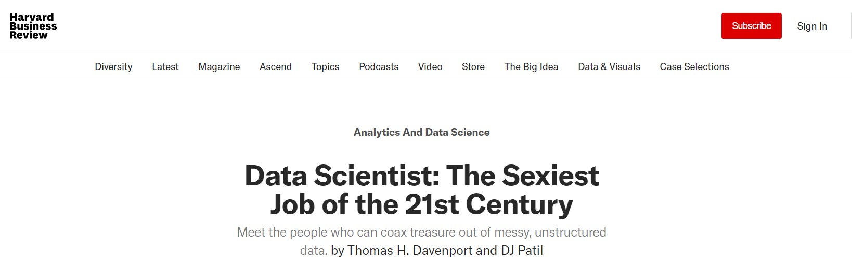
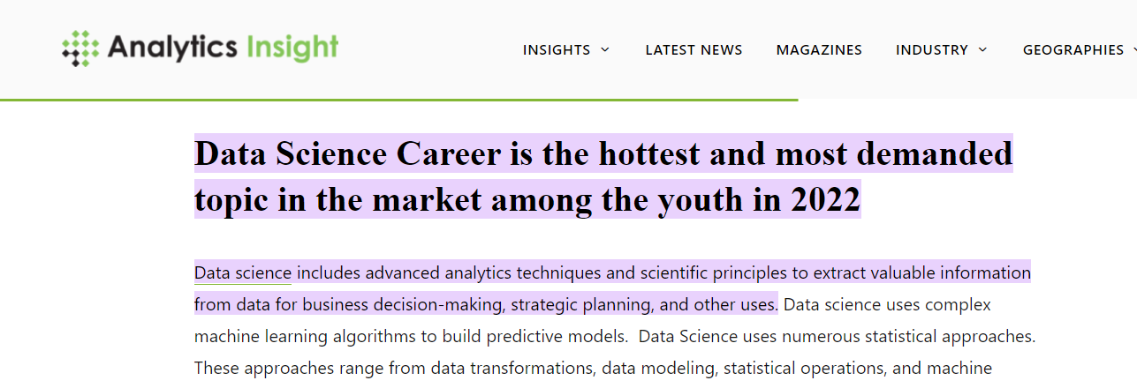

Slide 4
Table of contents
01
02
03
04
05
Objectives
About the dataset
Approach
Sexiest career ever!
Is it just a myth?
What’s the dataset like?
How did we deal with the dataset?
Data Insights
Conclusion
What did we find out from the dataset?
Take-home values for job seekers?

Slide 5
01
Objectives

Slide 6
01. Objectives
Data Job Landscape
Trends in Data Job Recruitment
Top Industries
Top Employers
Top Skill requirement
Insights for Job Seekers
Elements to take into consideration when Data Talents look for a new career jump

Slide 7
02. About the Dataset
3900 job listings for data-related positions in the USA
Hiring Company
Job Title
Job Level
Salary Estimate
Location
Job Description
and more.

Slide 8
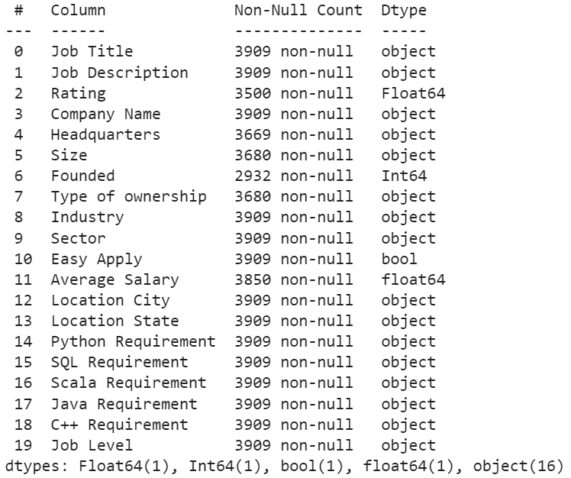
02. About the Dataset

Slide 9



Descriptive Analytics
03. Approach
Data Pre-processing
Data Visualization
Data Summary and Insights

Slide 10

04. Data Insights
Notes:
Bây giờ, chúng ta hãy đi vào những thông tin quan trọng được rút ra từ kết quả phân tích nhé

Slide 11
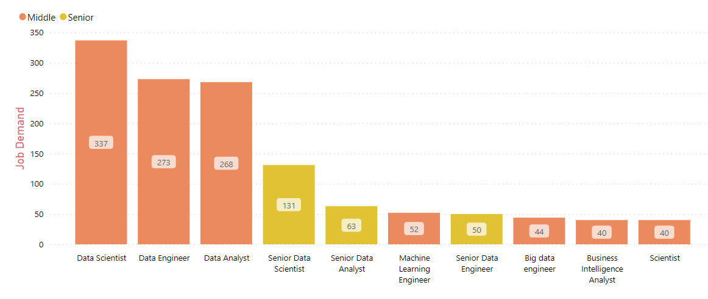
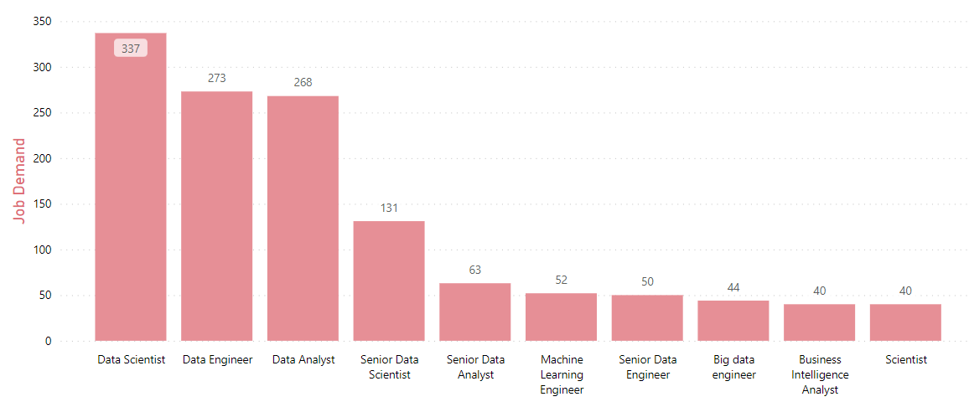
Job Demands for Data Talents
Extreme high demands for Data Scientist, Data Engineer & Data Analyst talents, mostly at Middle to Senior Level

Slide 12
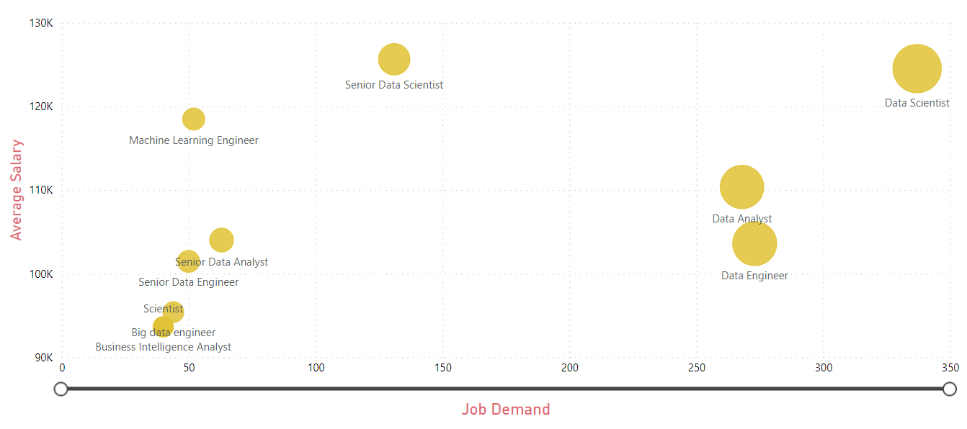
Demands and Salary by Job Categories
Top-paid Jobs: Data Scientist, Senior Data Scientist, Machine Learning Engineer

Slide 13
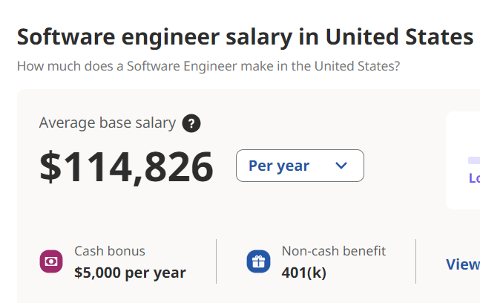
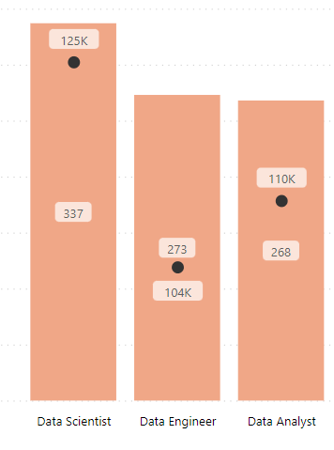
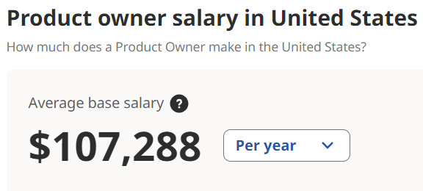
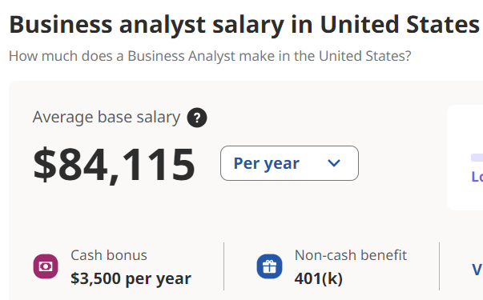
Data Job Salary in comparison with other tech roles

Slide 14
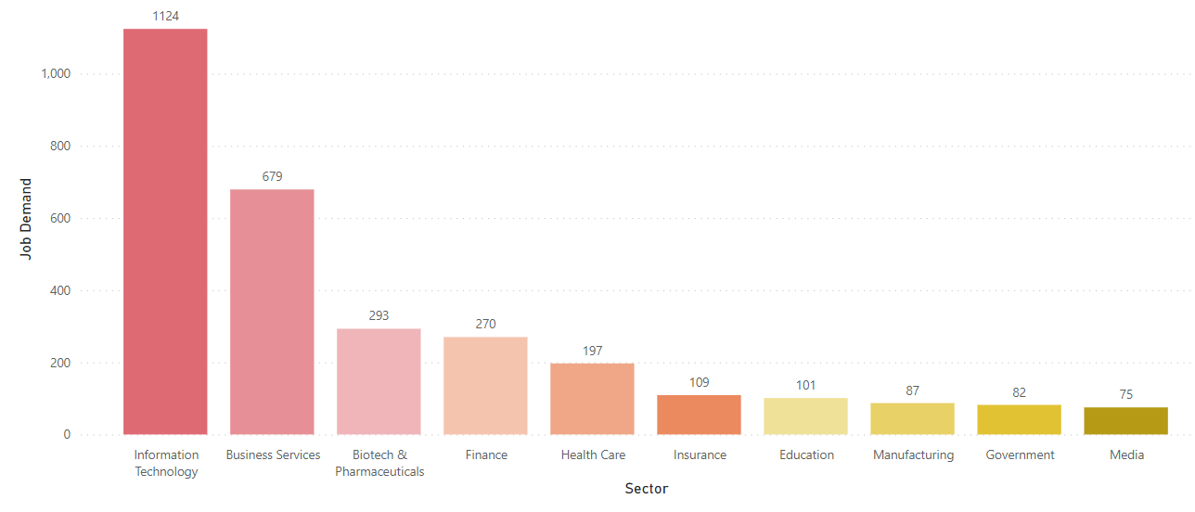
Job Demand by Sectors
Domain knowledge of an industry can indeed add significant value to the performance of data talents.

Slide 15
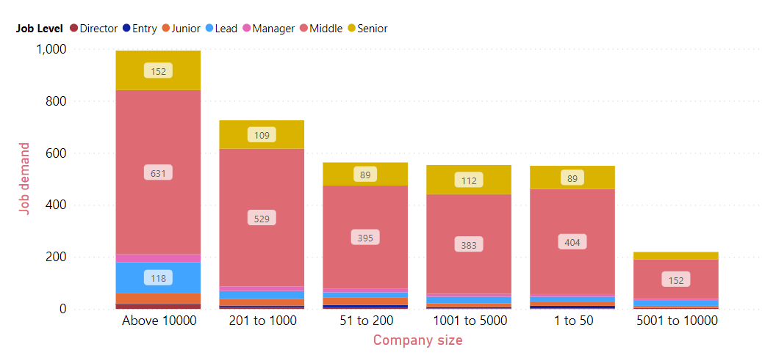
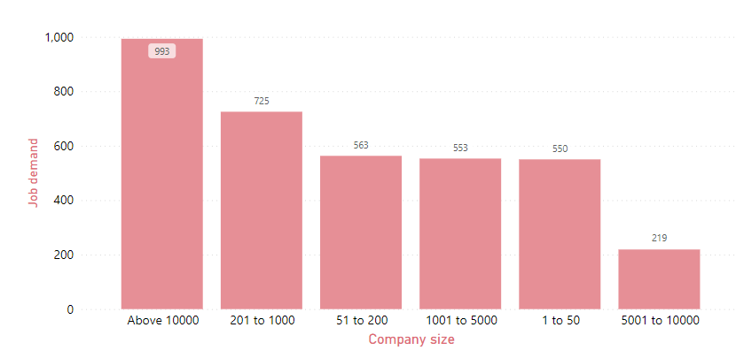
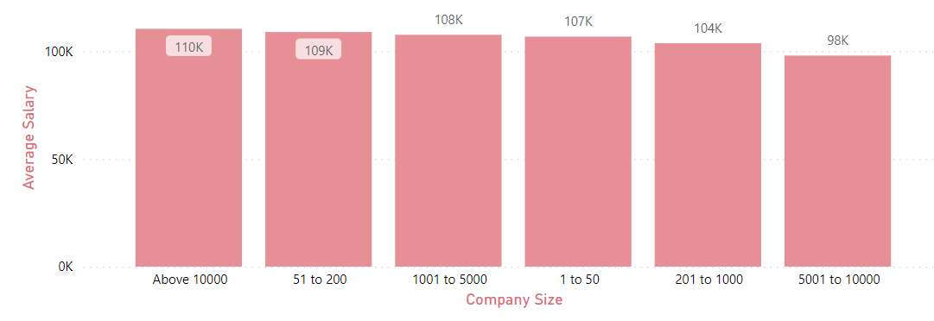
Job Demands and Salary by Company Size
Large firms (>10,000 ee) show great hiring demands across all levels.
Salaries vary regardless of the size of the company.

Slide 16
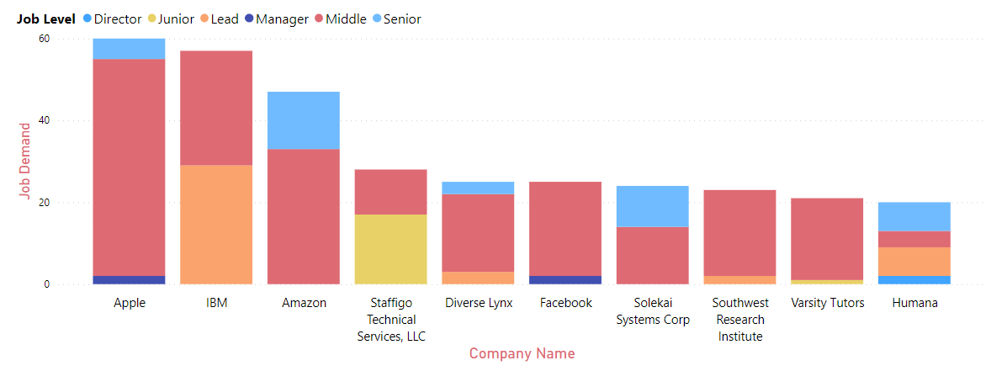
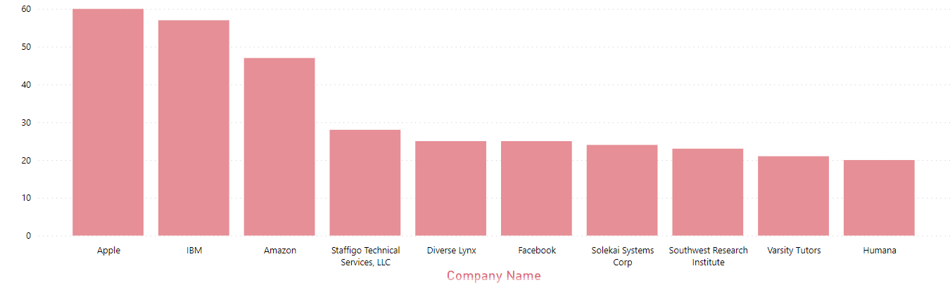
Job Demand by Companies
Multiple job opportunities could be found at Apple, IBM & Amazon
Staffigo is the most potential employer for junior-level candidates

Slide 17
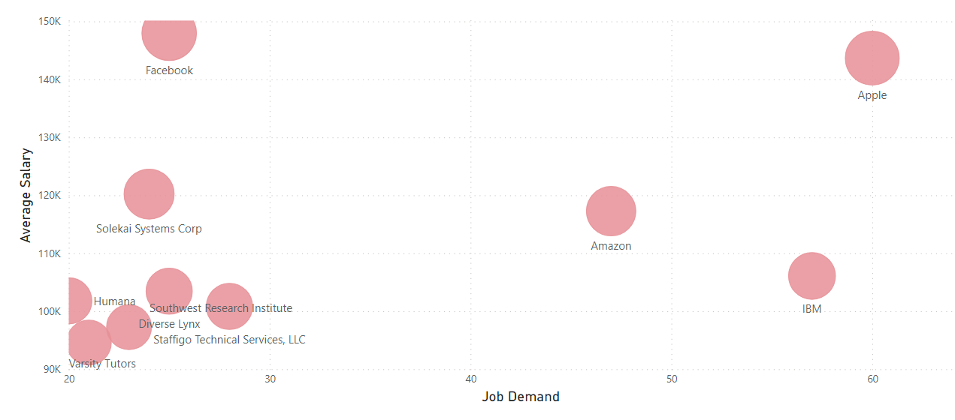
Job Demand & Salary by Companies
Apple and Facebook remain to be Top Employers that offer competitive salaries

Slide 18
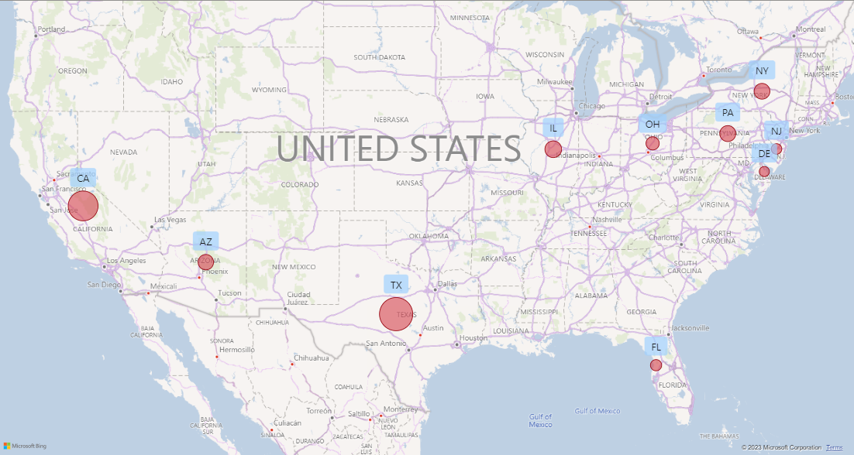
Job Demand by Location

Slide 19
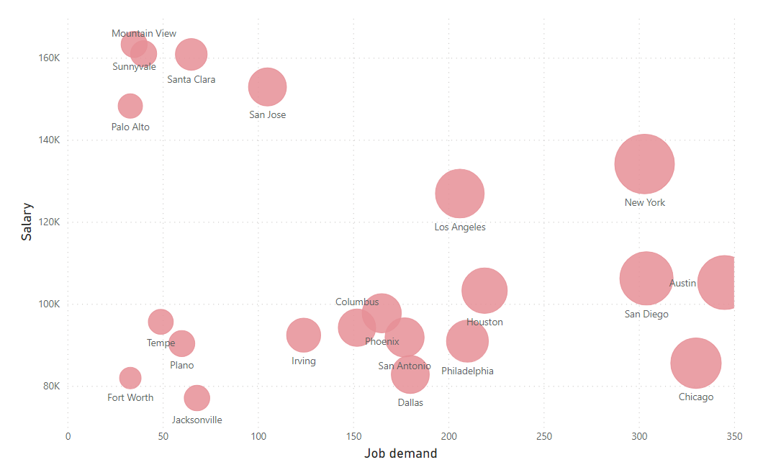
Job Demands and Salary by Location
Austin, Chicago, San Diego, New York, and Houston show great demand for data talent at all levels.
There is an extremely competitive market in San Jose, Santa Clara, Mountain View, and Sunnyvale (California).

Slide 20
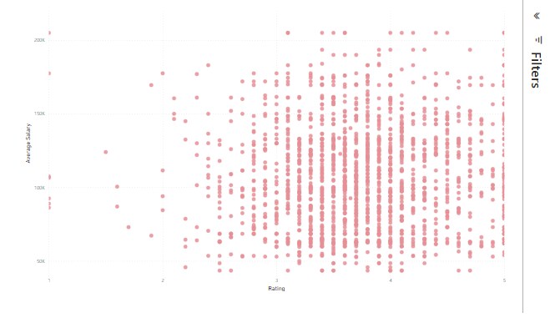
Relationship b/w Company Rating and Salary
There is no correlation between a company’s ratings and salary offers
A majority of companies included in the dataset are generally well-rated.
Different companies offer different salary levels, regardless of their ratings.

Slide 21
Job Requirement
Tech skills
Statistical & Analytical Thinking
Domain Knowledge
Clean & manipulate large datasets
Allow for context-specific analysis and insights
Identify patterns, trends & extract insights

Slide 22
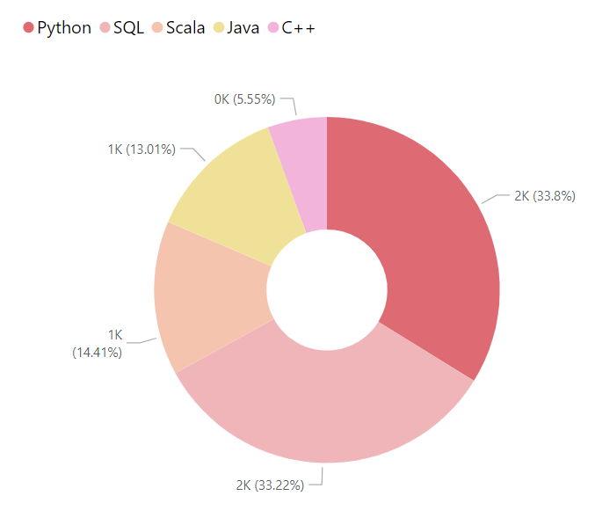
Top sought-after programming languages: SQL, Python, Scala
Skill Requirement

Slide 23
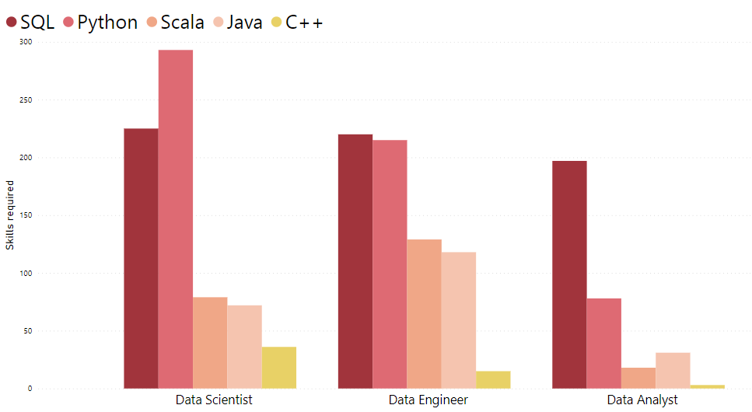
Skill Requirement by Job Categories
Python is the most in-demand skill for Data Science
For DE & DA, SQL is among the most essential skills

Slide 24
Conclusion
Are data talents in great demand?
Absolutely!

Slide 25
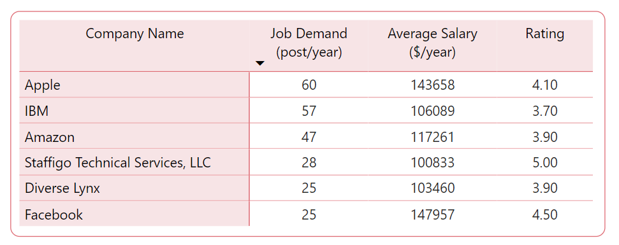
Conclusion
Top Employers

Slide 26
Conclusion
01. Job Market Highlight
Top skills
Top paid career
02. Elevating your career
Data Scientist ($125k/ year)
SQL & Python
Salary-affected Factors
Top employers
Top locations
Experience level
Skills
Companies
Working location
Apple & Meta
New York, Los Angeles & California
Top sectors
To get your dream job
IT, Business Services (Consulting, Staffing) & Biotech
Constantly-updating Competencies
Well-invested Portfolio

Slide 27
Thank you!
We’d love to hear your feedback!

